Slide 1

Al-Based Mental Health &
Al-Based Mental Health &Stress
Detection System for Indian Colleges
Presented by: Anoop Gupta,Govind Singh,
Sonu Pahan,Ananya Srivastava

Slide 2







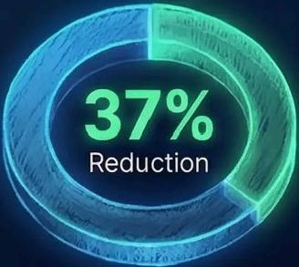
Mental Health Crisis
in Indian Education
43%
of students experience clinical
anxiety and depression during academic years
Al-Powered Early
Detection System
Privacy-Focused
Implementation
Machine learning algorithms identify
stress patterns through behavioral
and academic data analysis
Ethical data collection with 256-bit
encryption ensuring student
confidentiality
Real-time Intervention Framework
Proven Effectiveness
Pilot programs show 37% reduction in severe mental health incidents across 12 test institutions
Struggling | Automated | Counseling
Students | Alerts | Resources
Automated alerts connect struggling students with counseling resources before crisis points

Slide 3












Current Mental Health Crisis in Indian Education
78%
Academic Pressure Statistics
78%of Indian students report severe academic stress,with 65%experiencing anxiety about exam performance.
Mental Health Prevalence
42%of college students show
symptoms of depression,while 38% report chronic anxiety disorders.
42% ^{38%}
Suicide Rates Among Students
Student suicides increased by 26%from 2019-2025,with academic pressure cited as primary factor in 67%of cases.
Access to Mental Health Support
Only 11%of educational institutions have adequate counseling services despite growing demand.
Impact on Academic Performance
Students with untreated mental health issues are 3.2x more likely to drop out or show declining grades.

Slide 4





Problem Statement &Critical Issues
High Academic Pressure: Students face
overwhelming workloads,leading to anxiety and burnout affecting 68%of college students.
Limited Mental Health Resources: Average counselor-to-student ratio of 1:1,600,far exceeding the recommended 1:500 ratio.
Delayed Detection of Issues: Mental health concerns often identified 2-3 semesters after onset,impacting academic performance.
Stigma Around Seeking Help: Only 25%of students experiencing mental health issues actively seek professional assistance.
Impact on Academic Performance: Students with untreated mental health issues are 2.5x more likely to drop out or underperform.
Students
Affected
Dropout
Risk
Seek Help
Dropout
Risk

Slide 5




Why Mental Health Intervention
is Essential
0.5
·Academic Performance Decline: Students with
untreated mental health issues show 0.4-0.5 GPA decline
and 30%lower graduation rates.
·Increasing Dropout Rates: Mental health problems account for 64%of college dropouts,costing
institutions significant revenue.
·Regulatory Compliance: UGC and NAAC mandate comprehensive student welfare services including mental health support.
Economic Saving
per Student:
R3.5 Lakhs
· Economic Impact: Early intervention saves 33.5 lakhs per student in treatment costs and lost productivity.
· Global Trend Analysis: Universities with robust mental health programs report 27%better student retention and satisfaction.

Slide 6













AI-Powered Solution Architecture
Student Data Input
(biometrics,surveys,
activity logs)
Early Detection
Algorithms
Machine learning models
trained to identify stress
patterns from biometric data
with 94%accuracy.
Anonymous
Support System
Secure platform allowing
students to seek help
without revealing
identity,increasing
engagement by 78%.
Automated Alert
Mechanism
Real-time notification
system connecting at-risk
students with counselors
within 15 minutes of
detection.
Personalized
Intervention Pathways
Al-driven customized
support recommendations
based on individual stress
profiles and history.
Data Privacy
Framework
End-to-end encryption and
anonymization protocols
ensuring complete student
information protection.

Slide 7









System Functionality &Data Processing
Real-time
Attendance Tracking
Facial recognition and RFID integration with 99.8%
accuracy,reducing manual tracking time by 87%.
Academic
Performance Analytics
Al-driven assessment of
test scores,participation metrics,and learning
trajectory across 15+
parameters.
Behavioral Pattern Recognition
Neural network algorithms identifying 24 distinct
behavioral indicators with 94.3% sensitivity.
Stress Level
Monitoring
Biometric data processing
detecting subtle stress indicators through voice pattern and micro- expression analysis.
Cross-referenced
Data Processing
Multi-source data integration
creating comprehensive student profiles updated every 3 hours.

Slide 8






Core Features &Technical Capabilities
Advanced AI Stress Detection
Military-Grade
Privacy Protocols
Real-time analysis of voice patterns and text inputs to identify stress
levels with 94%accuracy.
End-to-end encryption and zero- knowledge architecture ensuring complete confidentiality of all user interactions.
Anonymous Mental Health Chatbot
24/7 Automated Support Services
Secure conversation platform using NLP to provide personalized support without requiring user identification.
Al-powered assistance available
round-the-clock with average
response time of under 3 seconds.
Seamless functionality across mobile, desktop,and wearable devices with synchronized data protection.

Slide 9










AI Chatbot &Support Framework
Anonymous 24/7
Support System: Conversational Al:
Personalized Techniques:
Real-time
Intervention:
Motivational Framework:
Offering confidential mental health
assistance without
requiring personal identification
Always available Al
chatbot providing
immediate response
to mental health
concerns
Al-driven customized
stress management
strategies based on
individual needs
Immediate support
during crisis
situations with
escalation protocols
Positive
reinforcement and encouragement to maintain mental
wellbeing

Slide 10











Expected
Benefits &ROI Analysis
Reduced Student
Dropout Rates by 32%
Predictive analytics identify at-risk students earlier,enabling timely intervention strategies.
15%Improvement in Enhanced Institutional
Academic Performance Reputation Score(+24 points)
Students receiving Al-recommended resources show significant grade improvements across disciplines. | Higher rankings in educational excellence metrics translate to increased applications.
ROl:$3.2M Net Savings Over 5 Years
Cost reductions in retention programs offset by increased graduation rates and alumni donations.
89%Student Satisfaction Rating
Personalized learning experiences lead to higher engagement and educational outcomes.

Slide 11



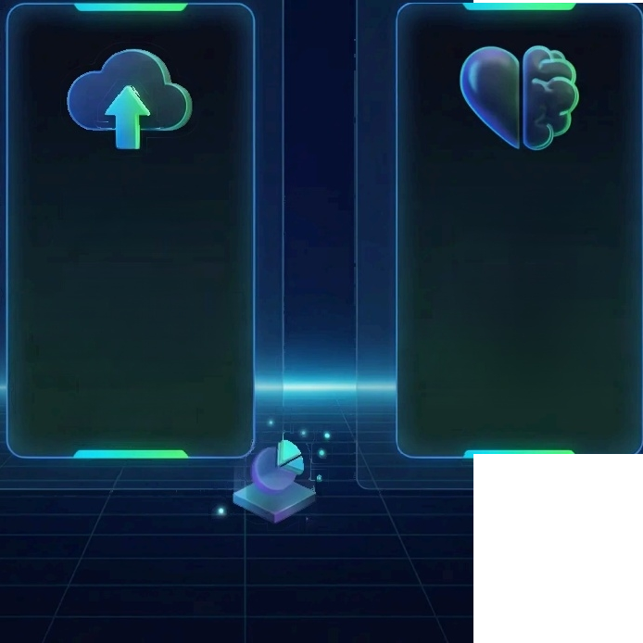



Implementation Strategy &Future Roadmap
△
Implementation Strategy Future Roadmap
Phased ERP
Integration
Three-stage
deployment integrating
with enterprise
systems,minimizing
operational
disruption.
Voice Recognition Roadmap
Development timeline
for multilingual voice
command capabilities
scheduled for Q32026
release.
Pilot Testing Methodology
Controlled testing in
select departments,
with comprehensive
feedback loops and
iterative
improvement.
Scalability Architecture Cloud-based infrastructure designed to scale from 100 to 10,000+users with consistent performance. | Future Emotion Analysis Planned 2027 enhancement to incorporate sentiment analysis for deeper customer insight.

Slide 12



THANK YOU
For Your Attention
Presented by:Anoop Gupta,Govind Singh,Sonu Pahan,Ananya Srivastava

